Slide 1
Configuring Web Applications

Slide 2

Overview
Servlet and JSP Mapping
Context Parameters Filters and Listeners

Slide 3
Servlet and JSP Mapping

Slide 4
Context Parameters

Slide 5
Filters

Slide 6
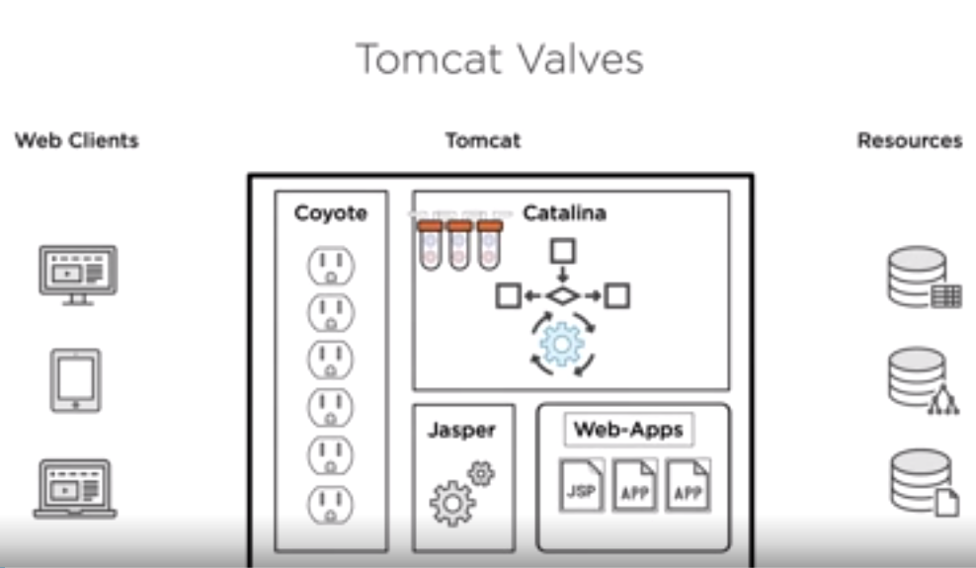

Slide 7
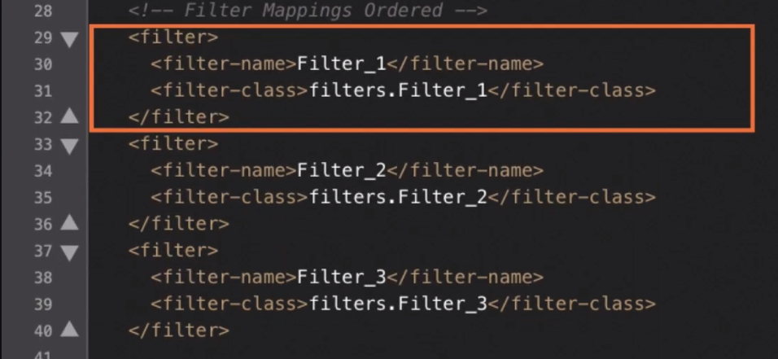

Slide 8
Configuring Filter Order
URL-patterns execute in order listed
localhost:8080/my_filters/
<filter-mapping>
<filter-name>Filter_1</filter-name>
<url-pattern>/*</url-pattern>
</filter-mapping>
<filter-mapping>
<filter-name>Filter_2</filter-name>
<servlet-name>/*</servlet-name>
</filter-mapping>
<filter-mapping>
<filter-name>Filter_3</filter-name>
<url-pattern>/*</url-pattern>
</filter-mapping>
Filter 1
Filter 2
Filter 3

Slide 9
Configuring Filter Order
Servlet names execute in order listed
localhost:8080/my_filters/
<filter-mapping>
<filter-name>Filter_1</filter-name>
<servlet-name>theservlet</servlet-name>
</filter-mapping>
<filter-mapping>
<filter-name>Filter_2</filter-name>
<servlet-name>theservlet</servlet-name>
</filter-mapping>
<filter-mapping>
<filter-name>Filter_3</filter-name>
<servlet-name>theservlet</servlet-name>
</filter-mapping>
Filter 1
Filter 2
Filter 3

Slide 10
Configuring Filter Order
URL-patterns are preferred over servlet names
localhost:8080/my_filters/
<filter-mapping>
<filter-name>Filter_1</filter-name>
<url-pattern>/*</url-pattern>
</filter-mapping>
<filter-mapping>
<filter-name>Filter_2</filter-name>
<servlet-name>/*</servlet-name>
<servlet-name>theservlet</servlet-name>
</filter-mapping>
<filter-mapping>
<filter-name>Filter_3</filter-name>
<url-pattern>/*</url-pattern>
</filter-mapping>
Filter 1
Filter 2
Filter 3

Slide 11
Configuring Filter Order
URL-patterns take precedence over servlet names
localhost:8080/my_filters/
<filter-mapping>
<filter-name>Filter_1</filter-name>
<url-pattern>/*</url-pattern>
</filter-mapping>
<filter-mapping>
<filter-name>Filter_2</filter-name>
<servlet-name>theservlet</servlet-name>
</filter-mapping>
<filter-mapping>
<filter-name>Filter_3</filter-name>
<url-pattern>/*</url-pattern>
</filter-mapping>
Filter 1
Filter 2
Fil
ter 3

Slide 12
Configuring Filter Order
IF different filters have url-patterns and servlet-names THEN url-patterns execute first
localhost:8080/my_filters/
<filter-mapping>
<filter-name>Filter_1</filter-name>
<url-pattern>/*</url-pattern>
</filter-mapping>
<filter-mapping>
<filter-name>Filter_2</filter-name>
<servlet-name>theservlet</servlet-name>
</filter-mapping>
<filter-mapping>
<filter-name>Filter_3</filter-name>
<url-pattern>/*</url-pattern>
</filter-mapping>
Filter 1
Filter 2
Fil
ter 3

Slide 13






Web Application
WAR
Servlet
Filter
Filter
web.xml
JSP
Filter

Slide 14
Overview
Configure web apps using web.xml
Map web apps to urls using servlet- mapping
Map filters to URLs using filter-mappings

Slide 15
Java Application Development with Tomcat
SUMMARY

